Slide 1
Image Management Tool
Github Link: https://github.com/ShenYongji/INFO5100_FinalProject
Author: Zhiming Xue; Yongji Shen

Slide 2
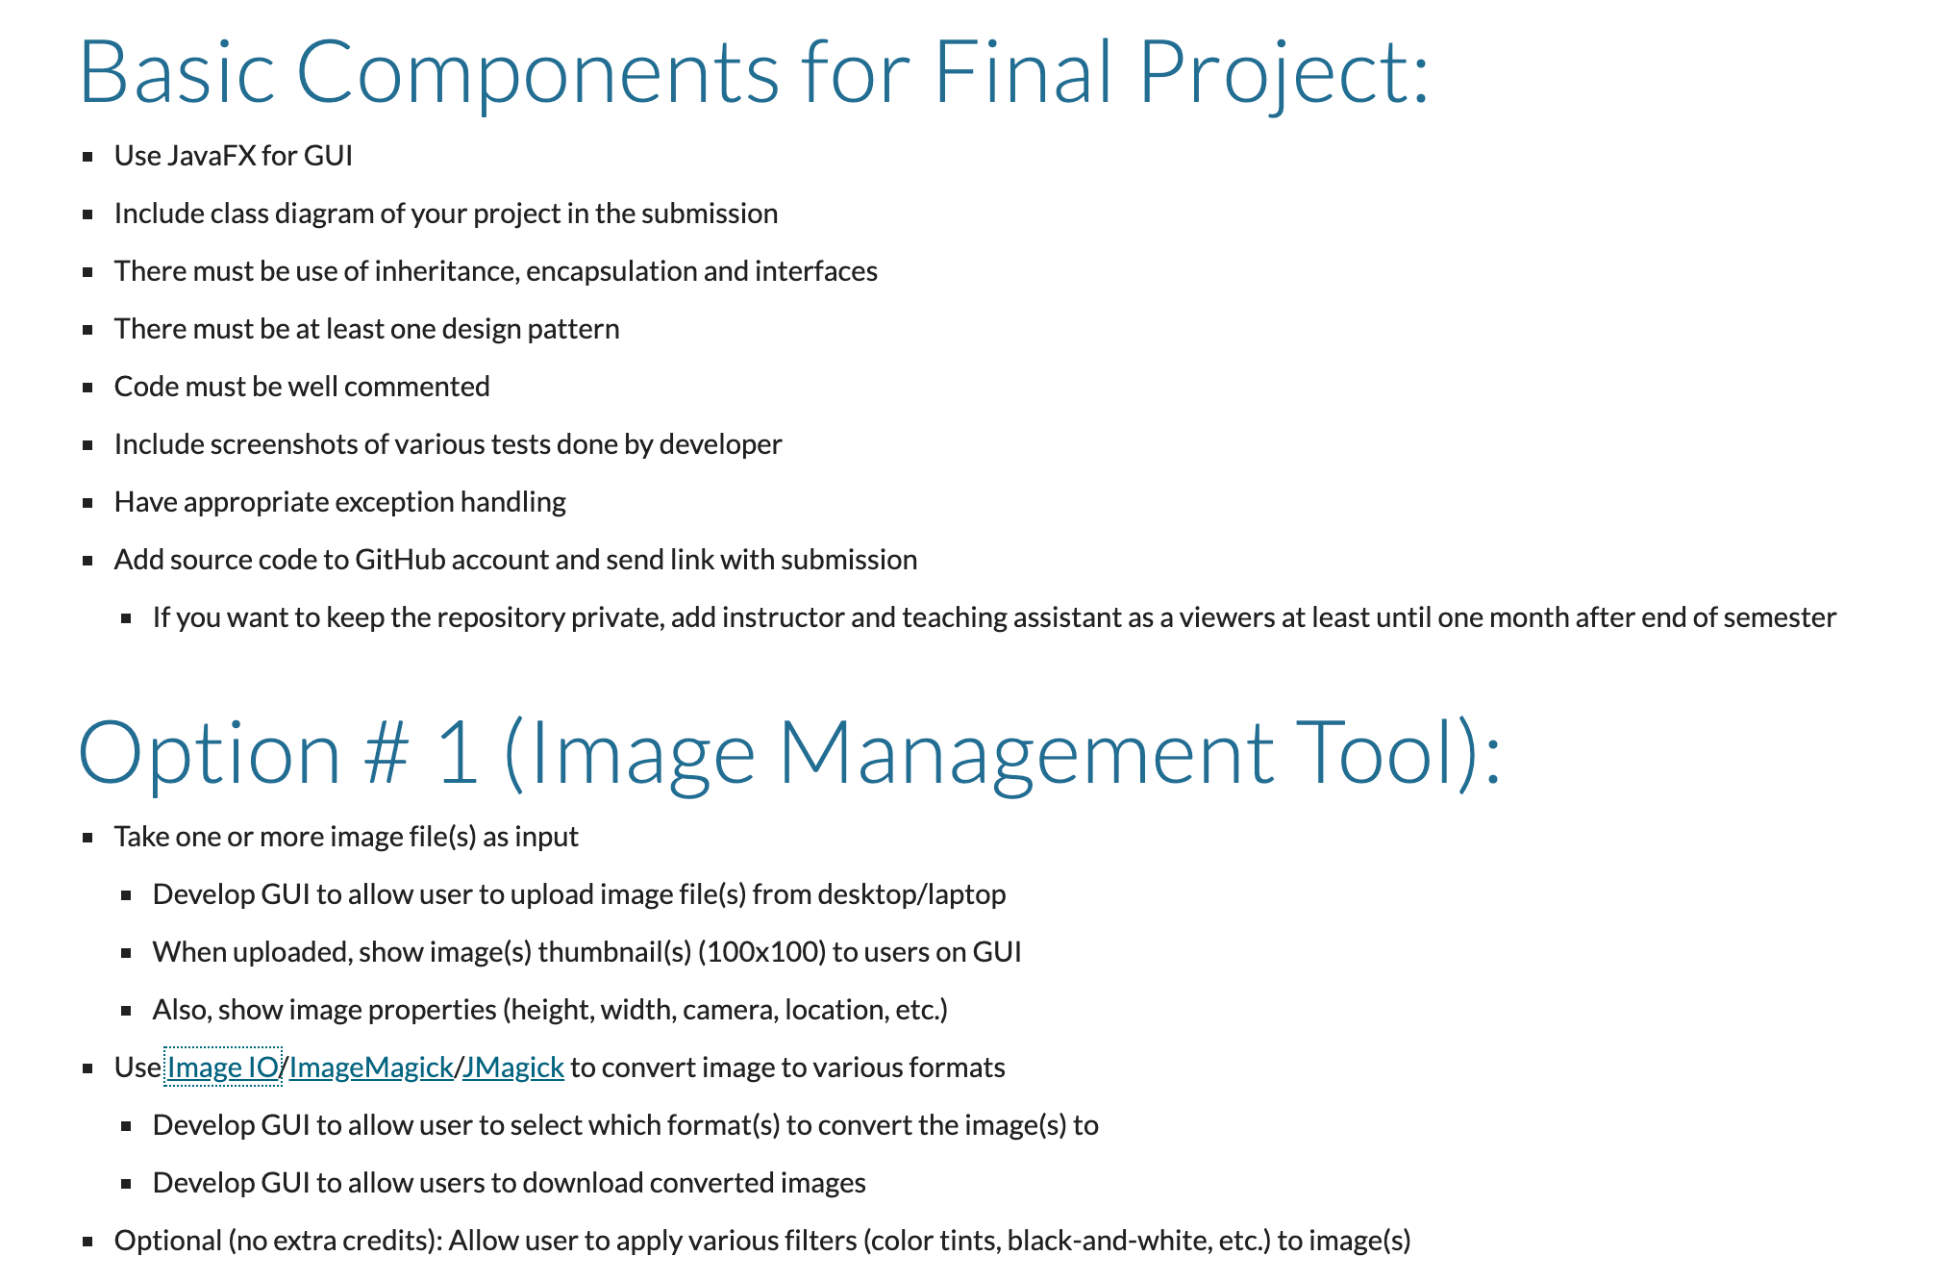
Requirement

Slide 3
Responsibility
Yongji Shen
Developed the mainUI page
Developed all the functions under the image filter button
Rotate, Desaturate
Zhiming Xue
Developed the preface page
Developed all the functions under the covert format button

Slide 4
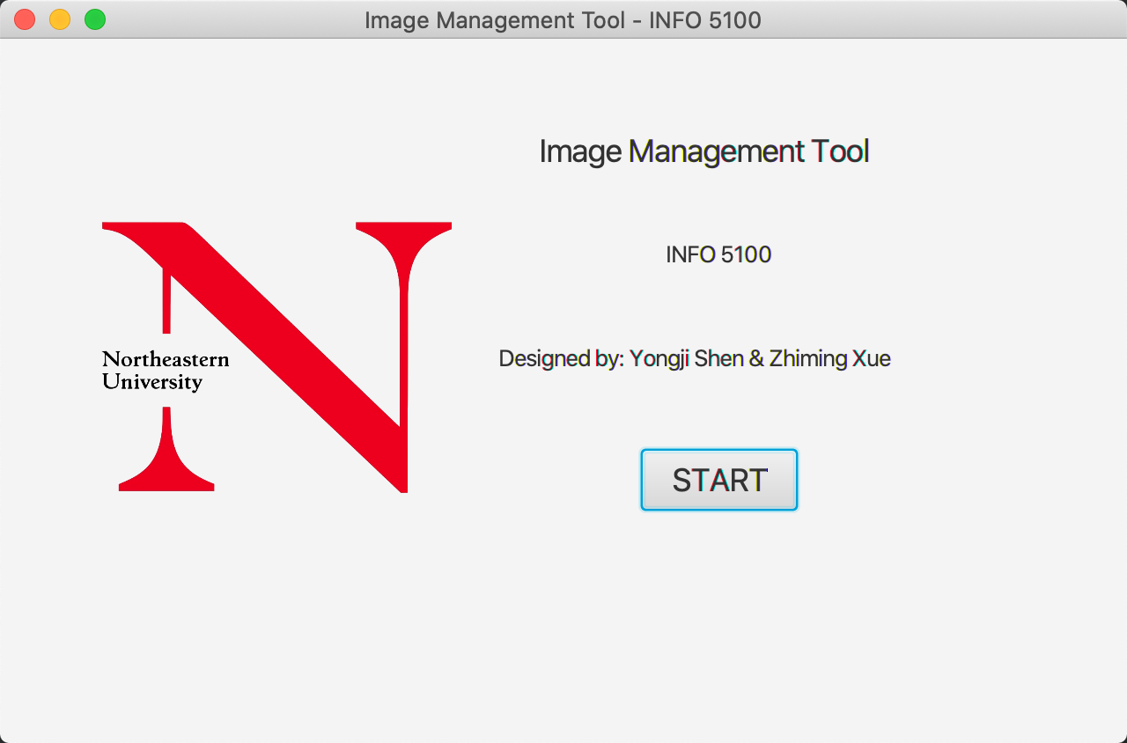
This is the preface of our program
Using the start button to start the program

Slide 5
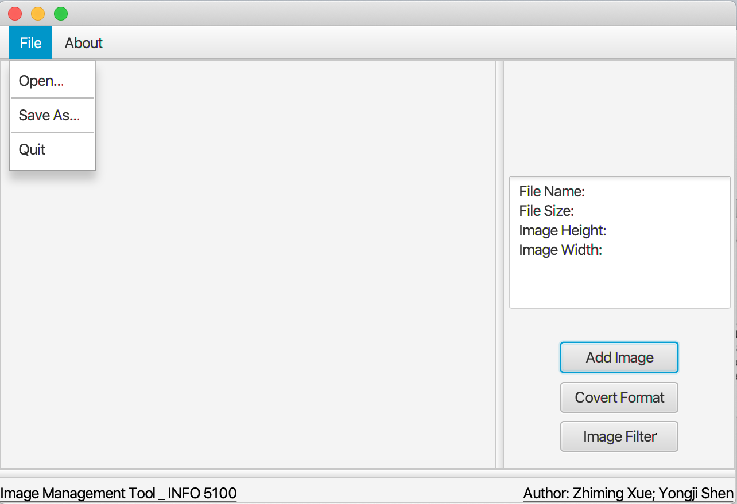
Github Address
User Interface
Upload Images
Image Preview
Save Images in Different Formats
Quit
Image Information
Upload Images
Image Preview
Save Images in Different Formats
Image Filter

Slide 6
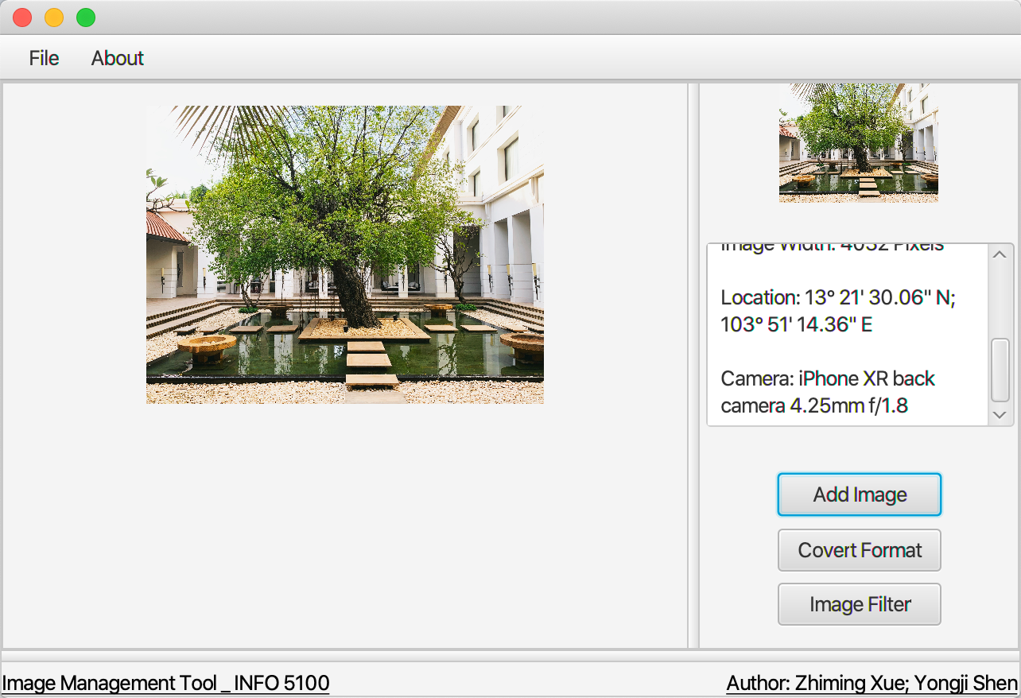
This is the mainUI of our program
Under the File button on the menu bar
You can open a new photo
You can save the image
You can quit the program
Under the About button on the menu bar
You can review the source code on Github
From the information window on the right
You can find some info of the photo you upload
Name, Size, Location, Camera etc.

Slide 7
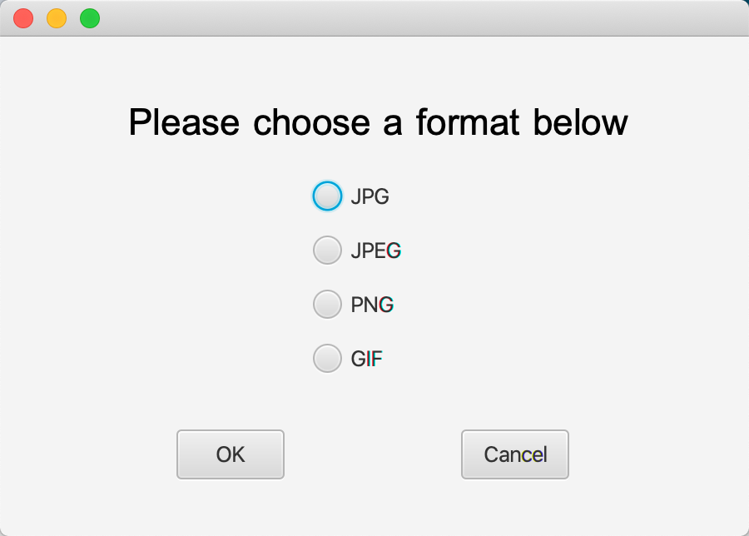
This is the mainUI of our program
Using Covert Format Button
You can choose several format to covert
JPG, JPEG, PNG, GIF

Slide 8
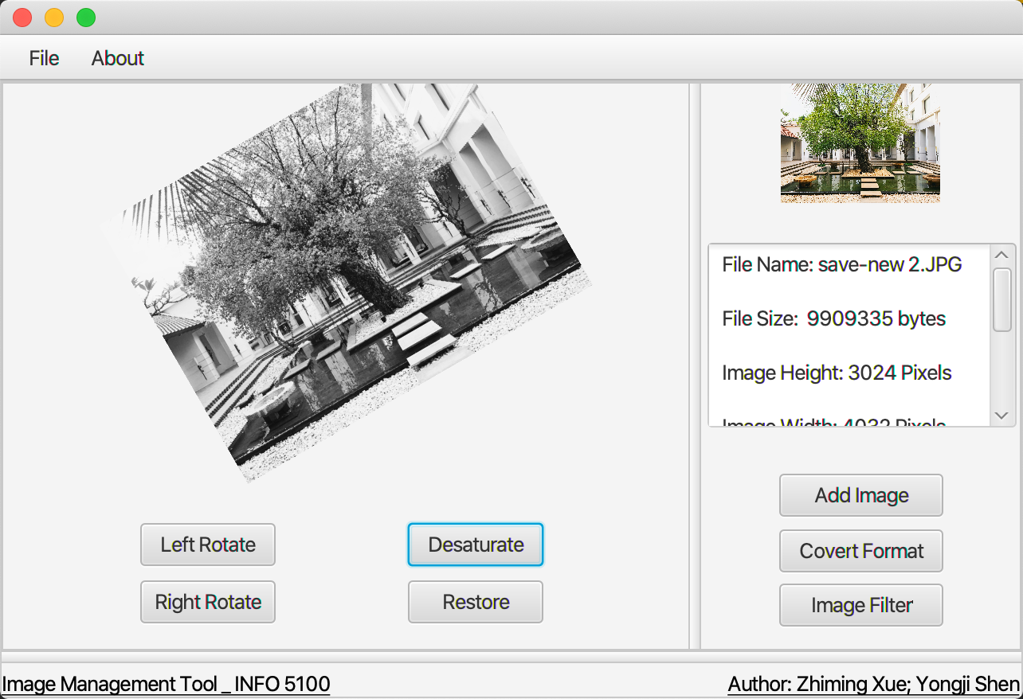
This is the mainUI of our program
Using Image Filter Button
After clicking the Image Filter Button, Program will display the hidden buttons show in picture
You can choose to rotate or desaturate the picture
Your actions will also be saved in the latest picture

Slide 9
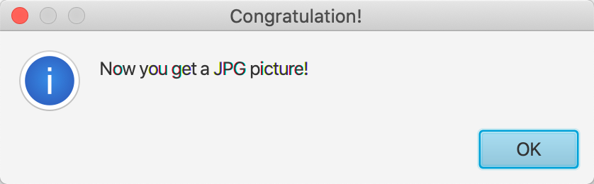
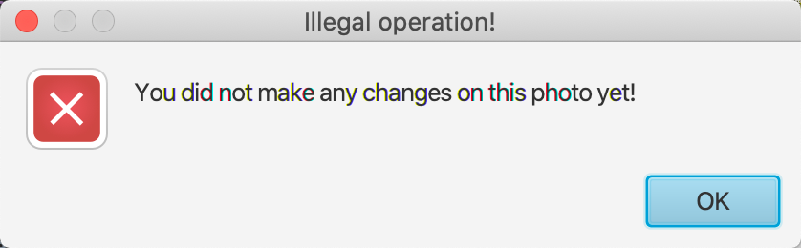
Kindly mentioned
We have set up several mentioning box to show whether your operations success or not

Slide 10
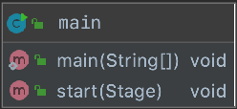
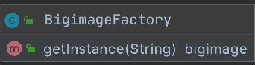
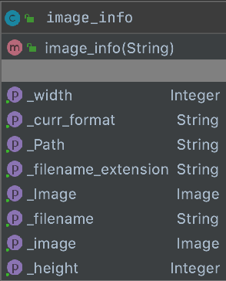
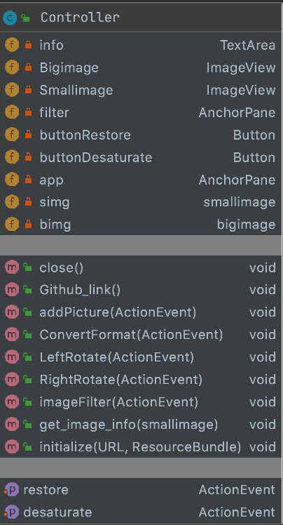
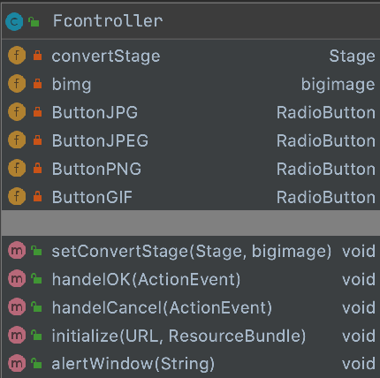
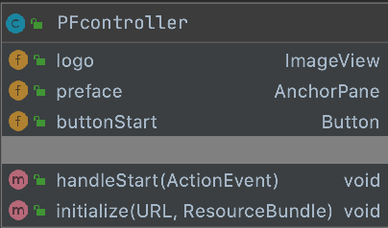
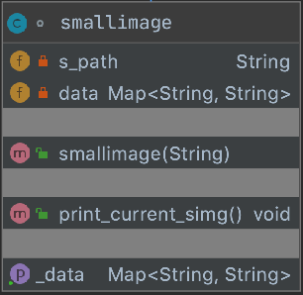
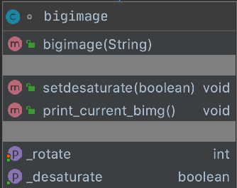

Class Diagram
main
BigimageFactory - Design Pattern
image_info
PFController
Controller
FController
smallimage
bigimage
preface
Format
mainUI

Slide 11
Test Cases - Adding Images
Image information is updated in real-time
while image is changed
Click to play

Slide 12
Test Cases - Converting Images
Converting Images in different format
Click to play

Slide 13
Test Cases - Image Filter
Adding filter on images
Click to play

